Slide 1
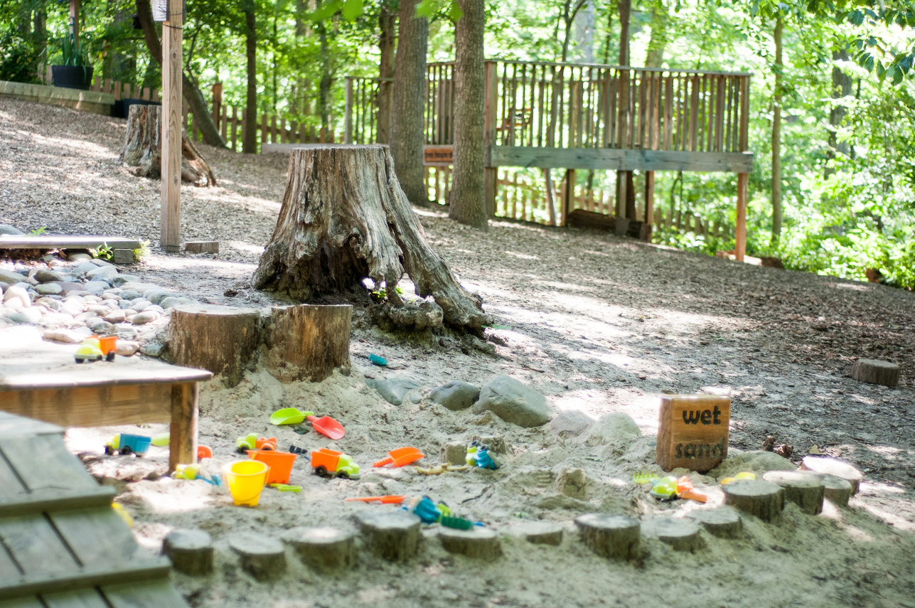
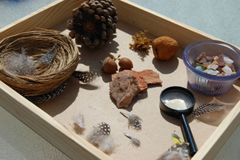
Yearly Plan
‘Nature’s Wonders’
Montessori Cultural Unit (Ages 3–6)
Learning to appreciate our world the Montessori way
By: Tredoux Willemse

Slide 2
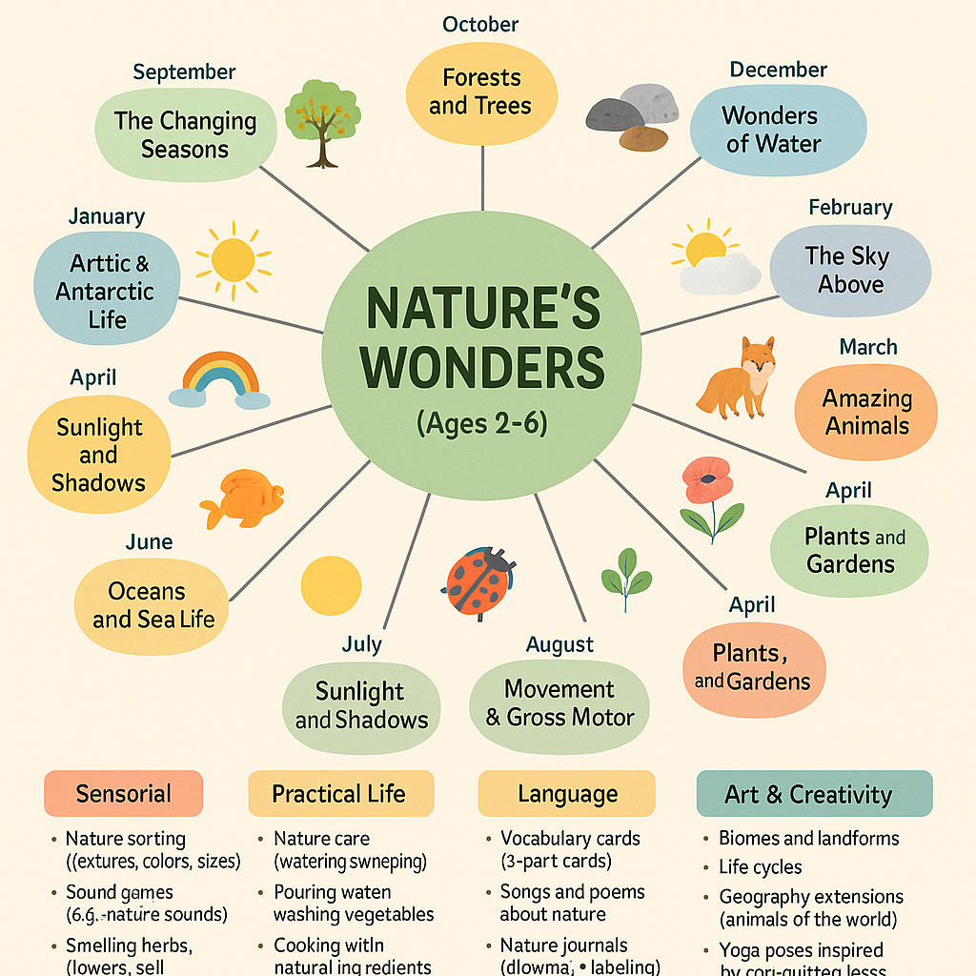

Slide 3
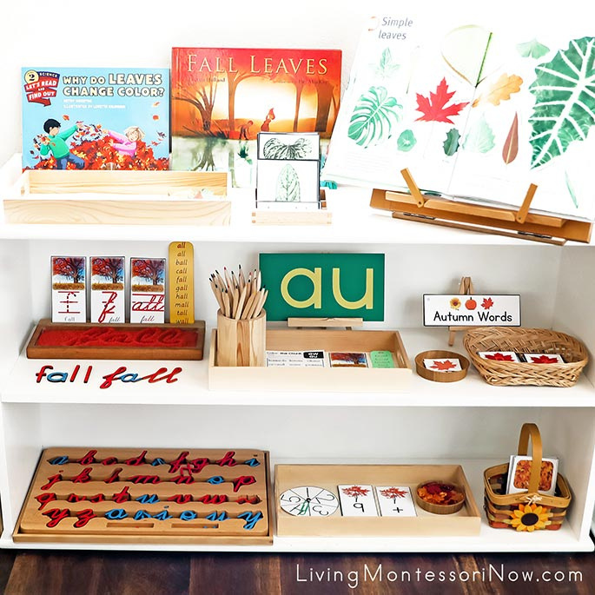
1. 🍂 Autumn (Seasons & Earth’s Changes)

Slide 4
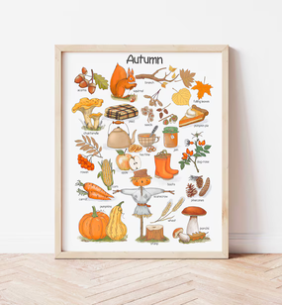
Introduction
Autumn is a time of transition — the Earth begins to rest, leaves change color and fall, animals prepare for winter, and we harvest the last fruits of summer. This unit invites children to observe and explore the wonders of this seasonal change through nature walks, sensorial work, classification, and hands-on activities rooted in Montessori principles.

Slide 5
Key Concepts & Objectives
- Recognize and name characteristics of the autumn season
- Understand the basic reasons for leaf color change and fall
- Identify parts of a tree and types of leaves
- Explore the life cycle of fall plants (e.g., pumpkin)
- Learn how animals prepare for colder months
- Develop daily weather awareness through observation

Slide 6
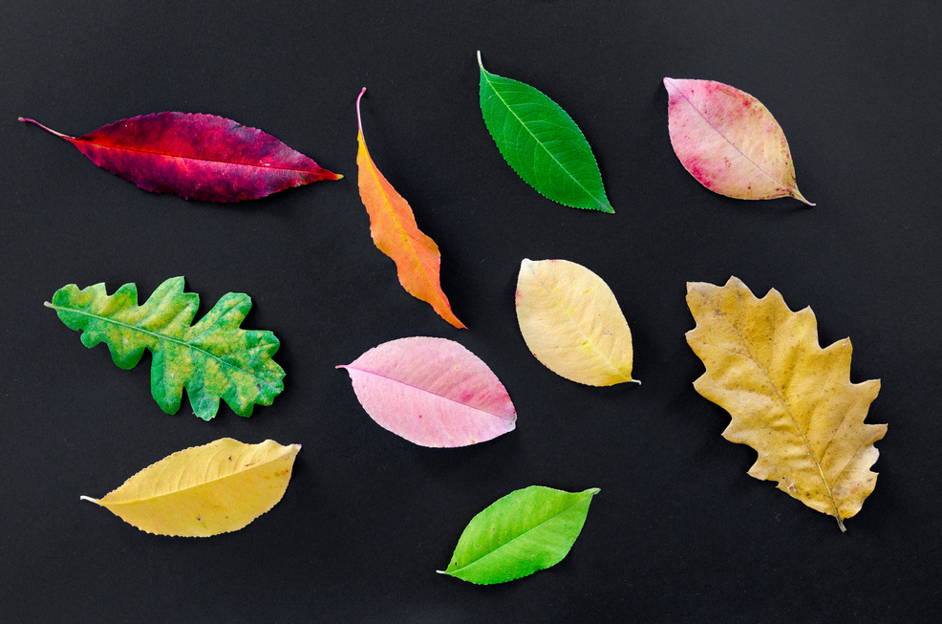
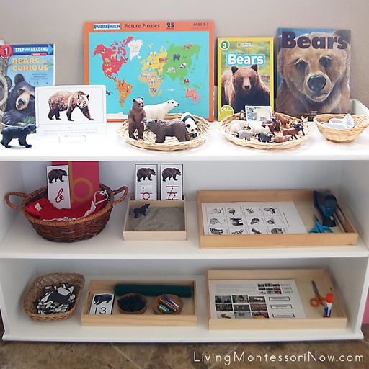
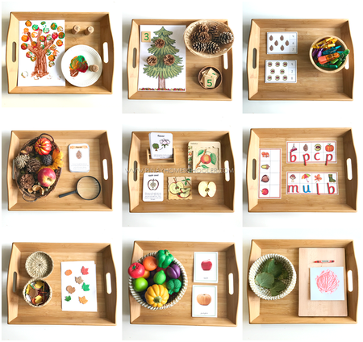
Key Vocabulary
Autumn, season, deciduous, evergreen
Leaf, trunk, bark, branch, root
Migration, hibernation, harvest
Chilly, windy, rainy, cloudy, crisp

Slide 7
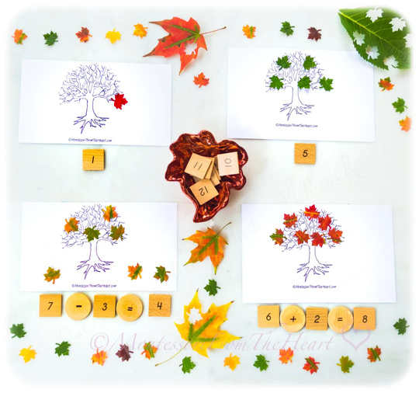
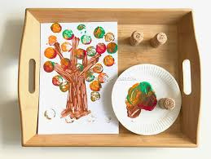
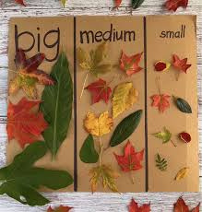
Activity: Leaf and Tree Study
Objective: Identify parts of a tree and observe leaf characteristics.
Materials: Real leaves, Tree puzzle, Leaf cards, Crayons
Presentation: Tree parts, leaf sorting, rubbings
Extensions: Create a Leaf Book, classify leaf types

Slide 8
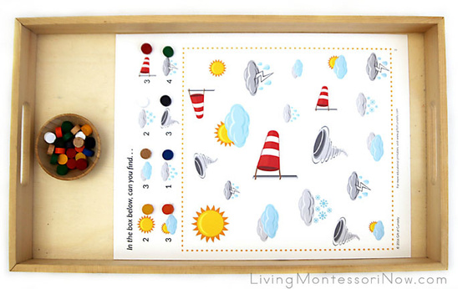
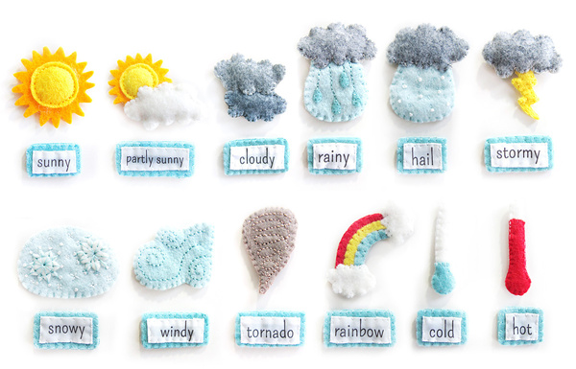
Activity: Weather Tracking
Objective: Develop weather pattern awareness.
Materials: Weather chart, icons, thermometer
Presentation: Daily observation, term introduction
Extensions: Weather graph, wind chimes

Slide 9
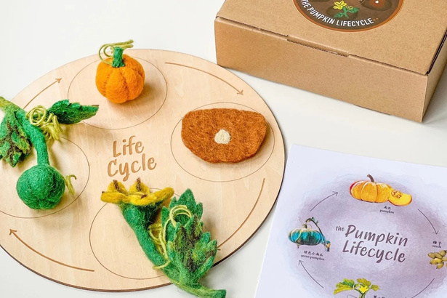
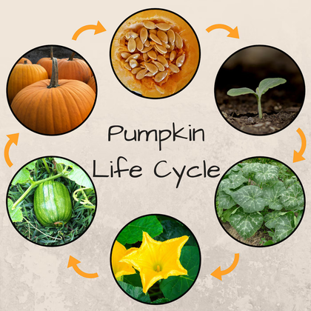
Activity: Pumpkin Life Cycle
Objective: Explore growth cycle of pumpkins.
Materials: Pumpkin, life cycle cards, cutting tools
Presentation: Explore pumpkin, sort parts
Extensions: Roast seeds, plant pumpkin seeds

Slide 10
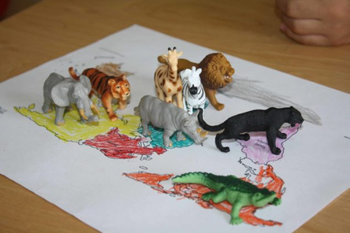
Activity: Animal Preparation
Objective: Learn animal seasonal behavior.
Materials: Animal cards, sorting chart
Presentation: Sort by migration/hibernation
Extensions: Model cave, animal behavior booklet

Slide 11
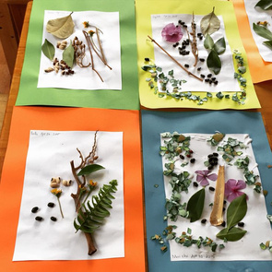
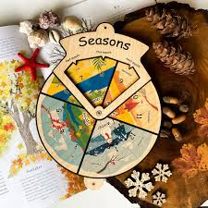
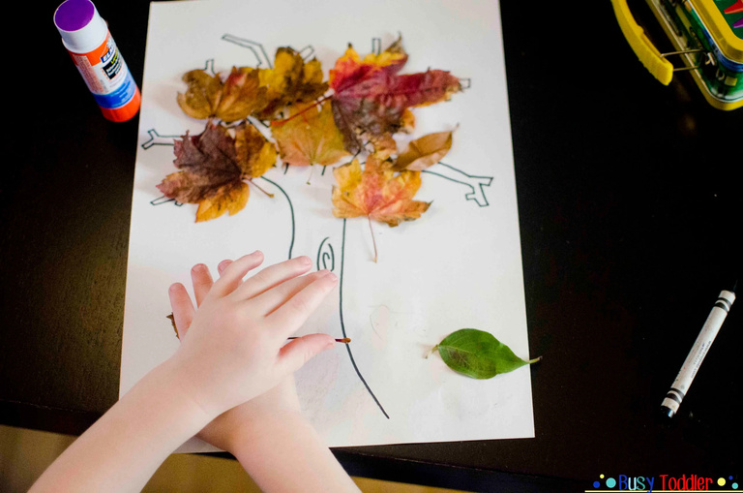
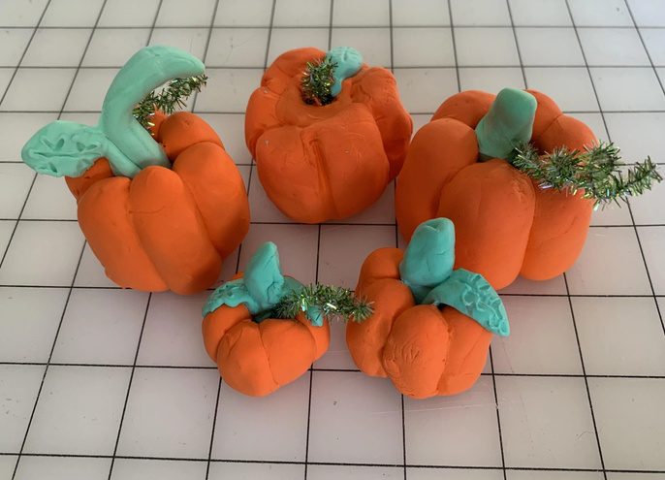
Creative Work
- Leaf printing
- Nature collages
- Seasons Wheel art
- Clay models of pumpkins or animals

Slide 12
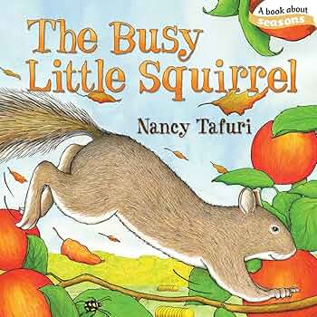
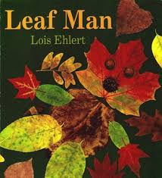
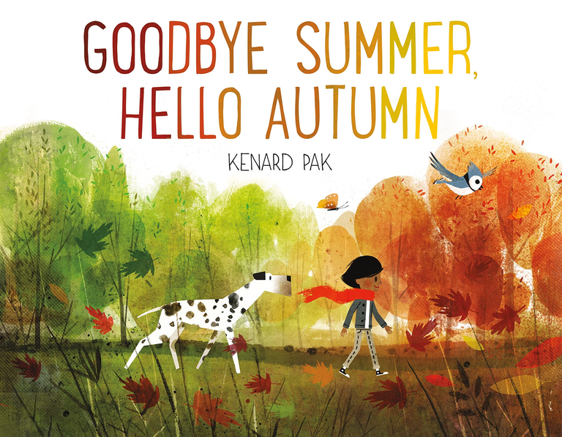

Recommended Books
- Leaf Man by Lois Ehlert
- Why Do Leaves Change Color? by Betsy Maestro
- The Busy Little Squirrel by Nancy Tafuri
- Goodbye Summer, Hello Autumn by Kenard Pak

Slide 13
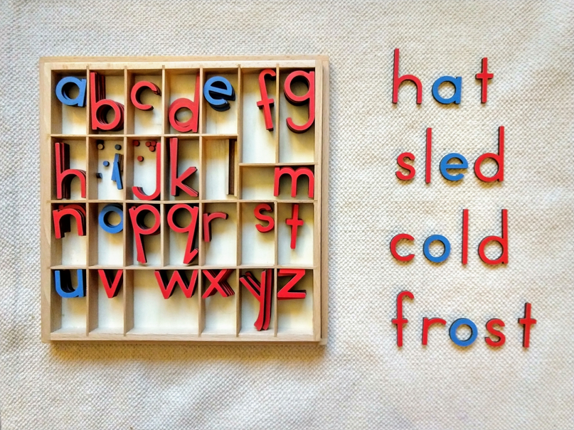
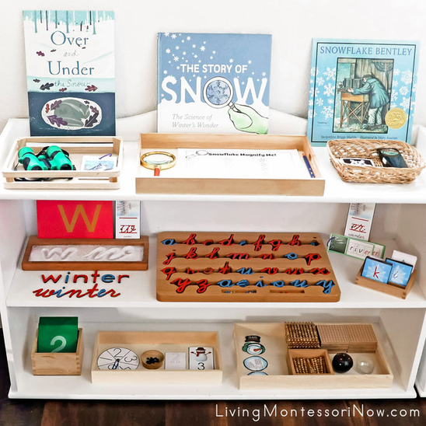
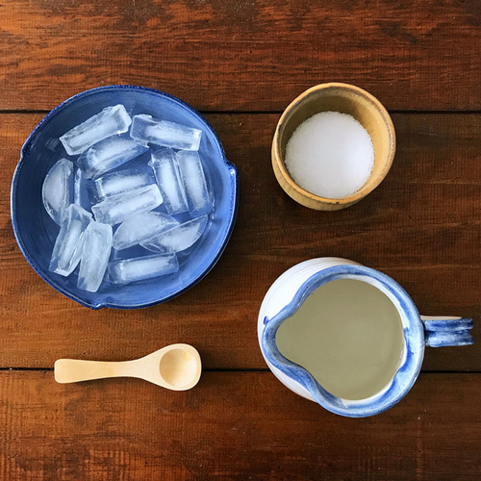
❄️ Winter: Cold & Quiet Wonders

Slide 14
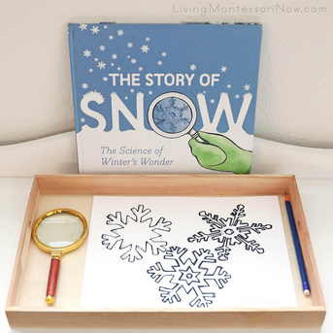
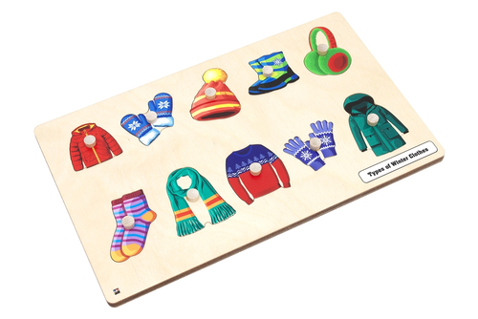
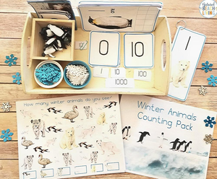
Introduction
Winter brings a quiet transformation to nature.snow falls, animals adapt, and the days grow short. This unit invites children to explore winter’s natural phenomena with experiments, art, and sensorial work that highlight cold-weather changes and celestial beauty.

Slide 15
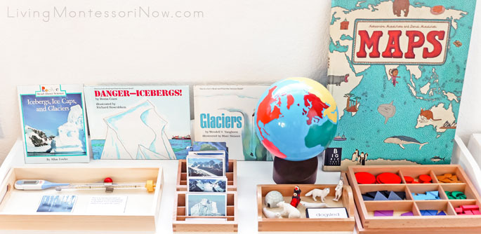
Key Concepts & Objectives
- Observe and understand states of matter (solid/liquid)
- Explore properties of ice, snow, and salt
- Identify and sort evergreen tree parts
- Learn about animals in polar climates
- Introduce night sky and constellations
- Develop scientific curiosity through sensory experiences

Slide 16
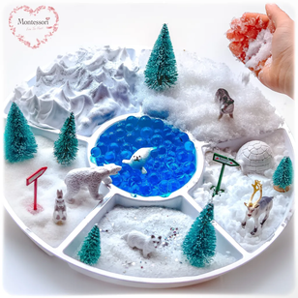
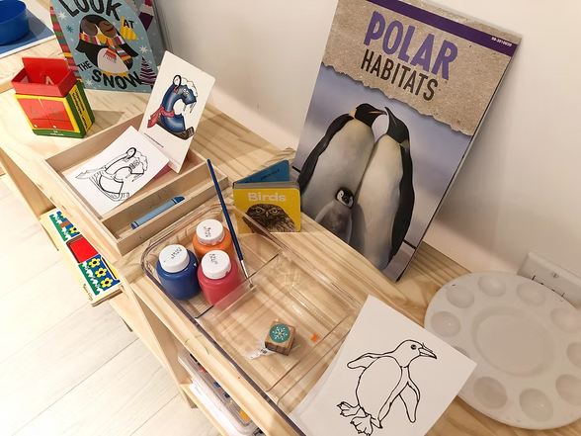
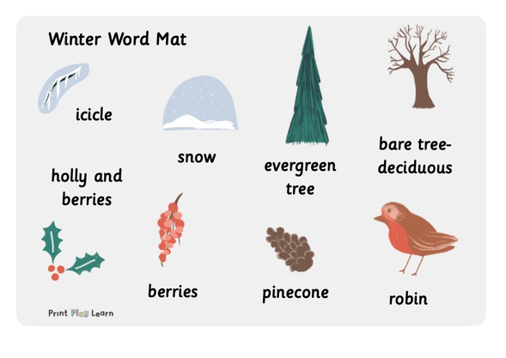
Key Vocabulary
Winter, cold, freeze, melt, solid, liquid
Evergreen, pinecone, needle, branch
Polar bear, penguin, hibernate, blubber
Star, moon, constellation, night, sky

Slide 17
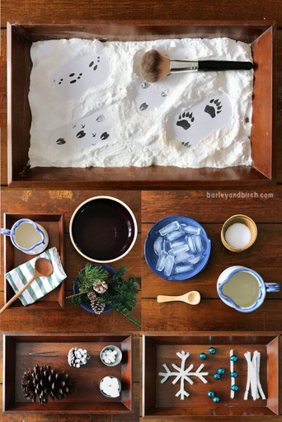
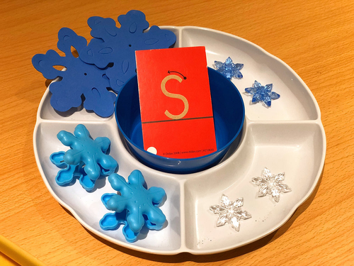
Activity: Snow and Ice Experiments
Objective: Explore freezing, melting, and salt reactions.
Materials: Ice cubes, salt, colored water
Presentation: Observe melting, record results
Extensions: Make ice lanterns or freeze nature items

Slide 18
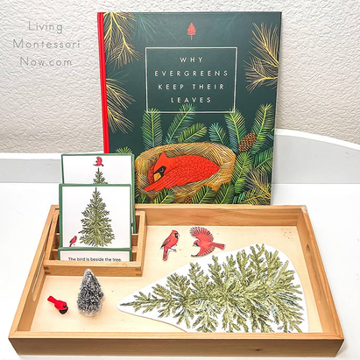
Activity: Evergreen Tree Study
Objective: Identify evergreen tree parts and differences.
Materials: Pinecones, branches, sorting trays
Presentation: Classify shapes, textures
Extensions: Pinecone art, nature wreaths

Slide 19
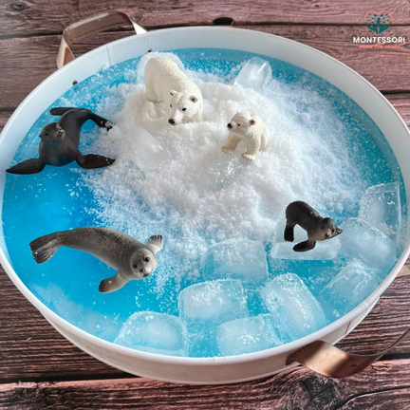
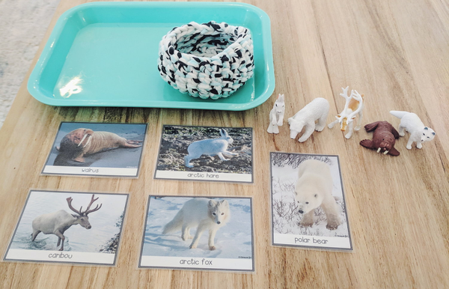
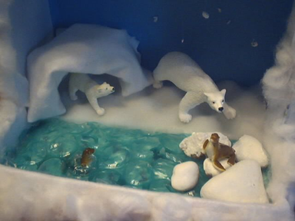
Activity: Polar Animal Exploration
Objective: Discover animal adaptations for cold.
Materials: Animal figurines, map, gloves, blubber demo
Presentation: Sort land vs. sea animals, globe review
Extensions: Blubber experiment with bags of fat & ice

Slide 20
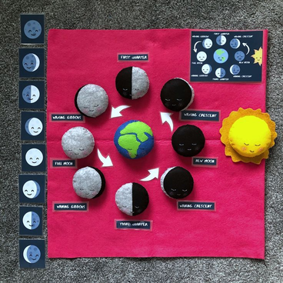
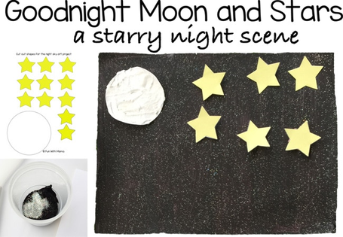
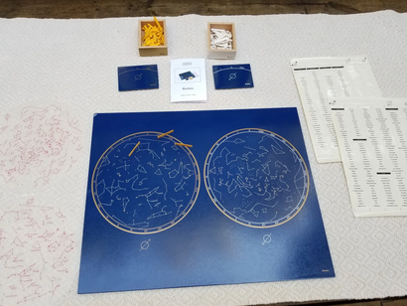
Activity: Stars and Night Sky
Objective: Learn about stars and constellations.
Materials: Flashlights, constellation cards
Presentation: Make constellation viewers, storytelling.
Extensions: Night sky drawing, moon phases with felt.

Slide 21
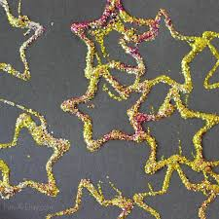
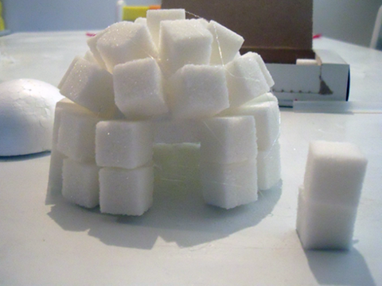
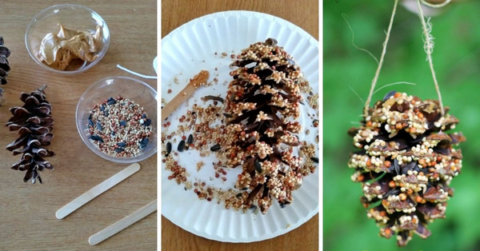
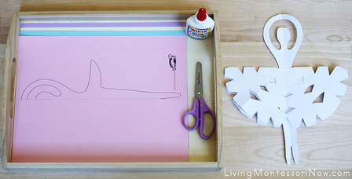
Creative Work
- Snowflake cutting
- Pinecone bird feeders
- Starry sky art with glitter
- Build an igloo with blocks or sugar cubes

Slide 22


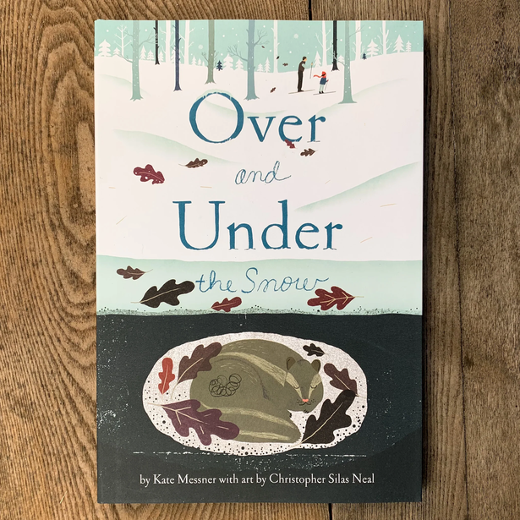

Recommended Books
- The Snowy Day by Ezra Jack Keats
- Over and Under the Snow by Kate Messner
- Polar Bear, Polar Bear, What Do You Hear? by Eric Carle
- Stargazers by Gail Gibbons

Slide 23
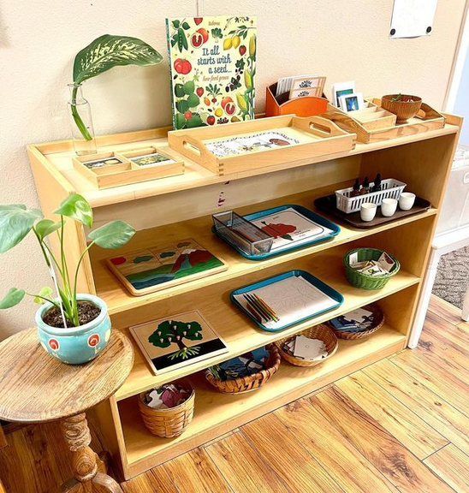
🌸 Spring: Growth & Renewal

Slide 24
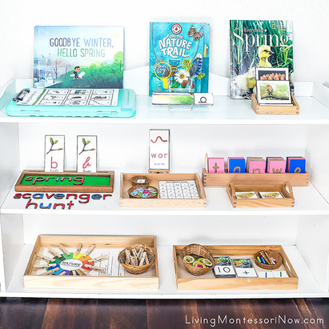
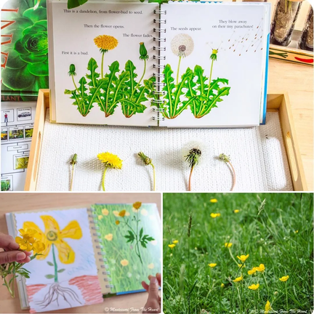
Introduction
Spring is a season of rebirth and renewal. Children explore how plants grow, insects emerge, and rain brings life to the earth. This unit offers sensorial and scientific experiences that celebrate the cycle of life and the wonder of transformation.

Slide 25



Key Concepts & Objectives
- Understand plant life cycles and growth needs
- Observe and document seed growth and root systems
- Learn about insects and their transformations
- Explore the water cycle through hands-on activities
- Discover how birds use natural materials to build nests

Slide 26



Key Vocabulary
Spring, seed, root, stem, leaf, flower
Butterfly, caterpillar, chrysalis, metamorphosis
Rain, cloud, puddle, evaporate, water cycle
Nest, twigs, feathers, hatch, beak

Slide 27

Activity: Seed Planting
Objective: Observe how seeds grow into plants.
Materials: Beans, clear cups, soil, water
Presentation: Place seeds against side of cup, watch roots grow
Extensions: Garden walk, flower dissection

Slide 28


Activity: Insect Study
Objective: Learn about insect life cycles.
Materials: Butterfly kits, lifecycle cards, magnifying glasses
Presentation: Match cards, observe real caterpillars
Extensions: Ladybug release, insect art

Slide 29



Activity: Rain & Water Cycle
Objective: Understand how water changes form.
Materials: Water jars, plastic wrap, heat lamp
Presentation: Observe evaporation and condensation
Extensions: Rain art with pipettes, cloud in a jar

Slide 30

Activity: Bird Nest Building
Objective: Discover how birds use materials to make nests.
Materials: Twigs, feathers, grass, yarn
Presentation: Show real nest photos, let children build nests
Extensions: Observe birds outside, nest art

Slide 31




Creative Work
- Spring nature collage
- Painted flower pots
- Coffee filter butterflies
- Raindrop mobiles

Slide 32




Recommended Books
- The Tiny Seed by Eric Carle
- Waiting for Wings by Lois Ehlert
- From Seed to Plant by Gail Gibbons
- In the Small, Small Pond by Denise Fleming

Slide 33

☀️ Summer: Sun, Sea & Sand

Slide 34


Introduction
Summer brings warmth, light, and outdoor adventures. This unit invites children to explore natural elements like sunlight, the ocean, and earth materials through creative, scientific, and sensorial experiences that spark curiosity and connection to nature.

Slide 35


Key Concepts & Objectives
- Understand ocean layers and marine life zones
- Explore the sun’s effect through hands-on art
- Classify rocks and minerals by properties
- Engage in nature-based crafts to develop fine motor skills

Slide 36



Key Vocabulary
Summer, sun, ocean, tide, wave, shell
Light, shadow, print, exposure, cyanotype
Rock, mineral, smooth, rough, hard, soft
Weave, yarn, stick, petal, texture

Slide 37


Activity: Ocean Layers Bottles
Objective: Understand the layers of the ocean and marine habitats.
Materials: Bottles, blue water, sand, small shells, plastic sea animals
Presentation: Layer materials to represent ocean zones
Extensions: Add glow-in-the-dark fish for deep sea

Slide 38

Activity: Sun Prints
Objective: Use sunlight to make art and understand light exposure.
Materials: Cyanotype paper, leaves, small objects
Presentation: Place objects on paper, expose to sunlight
Extensions: Shadow tracing, color fading experiment

Slide 39


Activity: Rock & Mineral Exploration
Objective: Identify and compare rocks and minerals.
Materials: Rock samples, sorting trays, magnifying glasses
Presentation: Classify by texture, color, hardness
Extensions: Hardness scratch test, rock washing station

Slide 40


Activity: Nature Weaving
Objective: Develop fine motor skills using natural materials.
Materials: Sticks, yarn, flowers, grass, leaves
Presentation: Create weaving looms with twigs
Extensions: Frame with cardboard, seasonal nature weavings

Slide 41




Creative Work
- Sand art jars
- Shell collage
- Painted rock pets
- Nature bracelets

Slide 42




Recommended Books
- Hello Ocean by Pam Muñoz Ryan
- A Rock Is Lively by Dianna Hutts Aston
- What Lives in a Shell? by Kathleen Weidner Zoehfeld
- Summer Days and Nights by Wong Herbert Yee

Slide 43
Montessori Monthly Cultural & Science Planner
For Ages 3–6 | Hands-on Thematic Activities | Year-Round Exploration

Slide 44
August – Rocks & Minerals
Theme: Exploring the natural world through stones, gems, and earth layers
Activity: Gemstone Washing Station
Materials: Small basin, water, soft brushes, tongs, gemstones, trays
Learning Goals:
Develop fine motor skills through washing and sorting
Learn the names and characteristics of common minerals and gemstones
Build vocabulary: smooth, rough, shiny, dull, hard

Slide 45
September – Trees & Leaves
Theme: Observing trees, leaf parts, and seasonal changes
Activity: Leaf Sorting by Shape and Size
Materials: Real or felt leaves, sorting trays, classification cards
Learning Goals:
Identify leaf shapes (lobed, toothed, needle-like)
Practice matching, sorting, and comparing sizes
Introduce the parts of a tree and leaf (stem, blade, vein)

Slide 46
October – Weather & Wind
Theme: Understanding weather patterns and wind as a force
Activity: Pinwheel Making
Materials: Colored paper, push pins, straws, scissors
Learning Goals:
Observe wind effects and direction
Learn basic weather vocabulary (clouds, rain, wind, sun)
Develop fine motor and sequencing skills through crafting

Slide 47
November – Animal Homes
Theme: Where animals live and how they build their homes
Activity: Build a Bird Nest
Materials: Twigs, mud (or clay), string, natural items
Learning Goals:
Understand how animals use materials for survival
Explore bird habitats and nesting behavior
Strengthen spatial and construction skills

Slide 48
December – Winter Solstice
Theme: Celebrating light in the darkness
Activity: Ice Lanterns with Candles
Materials: Balloons, water, leaves, berries, LED candles
Learning Goals:
Explore freezing and melting
Discuss seasonal changes and shorter days
Introduce winter solstice as a natural event

Slide 49
January – Snow & Ice
Theme: Exploring the properties of snow, ice, and cold habitats
Activity: Arctic Animal Small World
Materials: Ice cubes, plastic Arctic animals, sensory bin
Learning Goals:
Identify Arctic animals and their adaptations
Observe melting, texture, and temperature
Encourage imaginative play and storytelling

Slide 50
February – Love for Earth
Theme: Caring for the planet and making sustainable choices
Activity: Recycling Sorting Game
Materials: Bins labeled paper/plastic/metal/compost, clean recyclables
Learning Goals:
Sort materials by type
Learn about reusing and recycling
Foster respect and responsibility for the Earth

Slide 51
March – Seeds & Sprouts
Theme: Life cycles of plants and spring growth
Activity: Grow Grass Heads in Cups
Materials: Cups, potting soil, grass seeds, markers
Learning Goals:
Observe plant growth over time
Introduce parts of a seed and plant
Encourage daily care and observation

Slide 52
April – Bugs & Butterflies
Theme: Insect life cycles and metamorphosis
Activity: Live Caterpillar Observation
Materials: Caterpillar kit, magnifying glasses, observation journals
Learning Goals:
Observe metamorphosis firsthand
Identify basic insect parts (head, thorax, abdomen)
Foster patience and respect for living things

Slide 53
May – Flowers & Pollinators
Theme: Importance of pollinators in nature
Activity: Bee Pollen Transfer Activity
Materials: Cotton ball bees, paper flowers, colored powder or chalk
Learning Goals:
Understand the role of bees in pollination
Explore flower anatomy (petals, pollen, nectar)
Engage in imaginative role play

Slide 54
June – Ocean & Sand
Theme: Discovering marine life and coastal environments
Activity: Shell Sound Matching
Materials: Paired shells with hidden materials (rice, beads, sand)
Learning Goals:
Practice auditory discrimination
Learn about sea life and shells
Encourage exploration of ocean textures

Slide 55
July – Sun & Shadows
Theme: Light, heat, and daily rhythms
Activity: Shadow Play & Gemstone Washing Station (revisit)
Materials: Flashlights, figurines, sunlight, reflective gems
Learning Goals:
Observe how light creates shadows
Explore the sun’s role in light and growth
Repeat and extend gemstone washing with outdoor play

Slide 56
Lesson Plans

Slide 57
Lesson Plan: Watering Plants (Ages 3-5)
Lesson Title: Watering Plants Age: 3-5 years Area: Practical Life (Care of the Environment) Time: 15-20 minutes
Materials Needed:
Child-sized watering can
Small pitcher (for filling)
1-2 small potted plants
Sponge or cloth (for spills)
Tray (to organize materials)
Key Points:
✔️ Control of Error: Stop pouring when water drips from the pot. ✔️ Independence: Let the child pour without interruption. ✔️ Care of Environment: Teach respect for living things.
Lesson Steps:
Introduction (2 min):
Sit with the child near the plant.
Say: "Today, we will learn how to give water to plants. Plants need water to grow, just like we do!"
Demonstration (5 min):
Show how to fill the watering can from the pitcher (just enough for the plant).
Hold the spout close to the soil and pour slowly in a circle.
Say: "We pour gently so the roots can drink."
Check if water drips from the pot’s bottom (sign to stop).
Wipe spills with the sponge.
Child’s Turn (5-10 min):
Invite the child to try: "Now it’s your turn!"
Observe quietly—only help if needed.
Encourage: "You’re taking good care of our plant!"
Conclusion (2 min):
Say: "Now our plant has enough water. We can check again tomorrow."
Have the child return the watering can to its spot.

Slide 58
Lesson Plan: Smelling Jars (Ages 3-6)
Lesson Title: Exploring Scents – Smelling Jars Age: 3-6 years Area: Sensorial Time: 15-20 minutes
Materials Needed:
6-8 small identical jars (opaque or covered with fabric to hide contents)
Natural scent samples:
Fresh herbs (mint, basil, rosemary)
Dried flowers (lavender, rose petals)
Spices (cinnamon, cloves)
Citrus peel (orange, lemon)
Soil (for earthy scent)
Tray (to organize jars)
Optional: Matching picture cards for extension
Lesson Steps:
1. Introduction (3 min)
Invite the child: "Today, we’ll explore different smells using our noses!"
Show the jars: "Each jar has a special scent. Let’s discover them quietly."
2. Presentation (5 min)
Demonstrate:
Pick up one jar, gently shake it, and lift the lid.
Bring it close to your nose, inhale deeply, and make a thoughtful
face (e.g., "Mmm, this smells fresh!").
Close the lid and set it down.
Emphasize:
"We use gentle sniffs—no touching the inside!"
3. Child’s Turn (10 min)
Let the child explore one jar at a time.
Encourage descriptive words: "Does it smell sweet? Earthy? Strong?"
Optional Matching Game:
If using picture cards, ask: "Can you find the picture that matches this smell?"
4. Conclusion (2 min)
"Our noses help us learn about the world! You can try this again whenever you like."
Show how to return jars to the tray neatly.
Key Points:
✔ Control of Error: Jars are identical, so focus is only on scent (no visual clues). ✔ Extensions:
Pair scents with nature walks (e.g., smell real rosemary after jar activity).
Blindfold game ("Guess the scent!"). ✔ AMS Alignment:
Refines olfactory senses (Sensorial).
Builds vocabulary (Language).
Encourages concentration and quiet observation.

Slide 59
Lesson Plan: Leaf Rubbings (Ages 3-6)
Lesson Title: Exploring Nature – Leaf Rubbings Age: 3-6 years Area: Sensorial / Art / Science Time: 20-25 minutes
Materials Needed:
Fresh or dried leaves (various shapes/sizes, flat surfaces work best)
White paper (lightweight, cut into small sheets)
Peeled crayons (thick, in natural colors like green, brown, yellow)
Clipboard or hard surface (to stabilize paper)
Tray (to organize materials)
Optional: Magnifying glass for observing leaves
Key Points:
✔ Control of Error:
Leaf won’t show if moved or pressed too hard/softly. ✔ Extensions:
Science link: Discuss why leaves have veins.
Language: Introduce terms like "texture," "veins," "rubbing." ✔ AMS Alignment:
Refines fine motor skills (rubbing motion).
Connects art to nature (botany exploration).
Encourages observation and concentration.
2. Presentation (5 min)
Demonstrate:
Place a leaf vein-side up under the paper on the clipboard.
Hold the crayon sideways and rub gently over the paper.
Watch as the leaf’s shape and veins appear!
Emphasize:
"Press softly—let the leaf’s secrets show themselves."
3. Child’s Turn (10-12 min)
Let the child choose a leaf and try.
Encourage exploration:
"What happens if you use a different color?"
"How does a big leaf’s rubbing look compared to a small one?"
Optional Extensions:
Sort leaves by shape/size before rubbing.
Label rubbings with the tree’s name (e.g., "Maple," "Oak").
4. Conclusion (2 min)
"You’ve made beautiful leaf art! Would you like to display it or save it in your nature journal?"
Show how to return materials to the tray.

Slide 60
Lesson Plan: Seed Counting (Ages 3-6)
Lesson Title: Counting with Seeds Age: 3-6 years Area: Mathematics (Number Sense & Quantity) Time: 15-20 minutes
Materials Needed:
Small bowl of large seeds (e.g., sunflower, pumpkin, or beans)
Number cards (1-10, or custom to child's level)
Small containers (cups or bowls for sorting)
Tweezers or small spoon (optional, for fine motor practice)
Tray (to organize materials)
Key Points:
✔ Control of Error:
Child can recount seeds to check accuracy.
Number cards provide visual feedback. ✔ Extensions:
Nature link: Use seeds from a class garden.
Fine motor: Add tweezers for transferring seeds.
Language: Introduce terms like "more/less," "add," "total." ✔ AMS Alignment:
Links concrete (seeds) to abstract (numbers).
Builds one-to-one correspondence (critical for math).
Encourages independence and problem-solving.
Lesson Steps:
1. Introduction (3 min)
Invite the child: "Today, we’ll count seeds! Can you help me match numbers to the right amount?"
Show the materials: "We have seeds, numbers, and cups to sort them."
2. Presentation (5 min)
Demonstrate:
Pick a number card (e.g., "3").
Say: "This is number three. Let’s count three seeds together."
Slowly place seeds one-by-one into a container while counting aloud.
Place the number card next to the container.
Emphasize:
"One seed for each number—let’s check if we have the right amount!"
3. Child’s Turn (10 min)
Let the child choose a number card and count seeds independently.
Extensions (based on skill level):
Beginner (3-4 yrs): Count seeds with guidance (1-5).
Intermediate (4-5 yrs): Match seeds to number cards (1-10).
Advanced (5-6 yrs): Add simple problems ("If you have 2 seeds and add 3 more, how many do you have?").
4. Conclusion (2 min)
"Great work! You matched all the numbers to their seeds. Would you like to try a bigger number next time?"
Show how to return seeds and cards to the tray.

Slide 61
Lesson Plan: Small Object Box
Materials Needed:
Small objects/pictures representing the words:
Plastic/rubber snail
Miniature nest (or picture)
Small piece of log (or wooden block)
Movable alphabet letters: s, n, l, o, g, a, i, e, t
Tray (to organize objects)
Small basket or box (to hold objects)
Optional: Matching word cards (for readers)
Key Points:
✔ Control of Error:
Objects have distinct starting sounds (/s/, /n/, /l/).
Teacher can gently correct mispronunciations. ✔ Extensions:
Sound Hunt: Find other classroom objects with /s/, /n/, /l/.
Tracing: Write letters in sand or on paper. ✔ AMS Alignment:
Develops phonemic awareness (critical for reading).
Uses concrete objects to teach abstract sounds.
Encourages independence with movable alphabet.
Lesson Steps:
1. Introduction (3 min)
Invite the child: "Today, we’ll listen to the beginning sounds of words. Let’s explore these special objects!"
Lay out the three objects (snail, nest, log) one at a time, saying each word clearly:
"This is a sssnail. Can you say 'sssnail'?" (Emphasize /s/)
"This is a nnnest. Listen: 'nnnest'." (Emphasize /n/)
"This is a lllog. Say 'lllog' with me." (Emphasize /l/)
2. Presentation (5 min)
Sound Matching Game:
Ask the child to pick up an object and say its name.
Isolate the first sound: "What’s the first sound in 'sssnail'? /s/!"
Match the sound to the movable alphabet letter: Place the "s" next to the snail.
Repeat for "nest" (/n/) and "log" (/l/).
3. Child’s Turn (10 min)
Activity 1: "Bring Me" Game
Ask: "Can you bring me the object that starts with /s/?" (Child selects "snail.")
Repeat for /n/ and /l/.
Activity 2: Building Words (for older children)
Use the movable alphabet to spell "snail," "nest," and "log" next to each object.
Optional: Match pre-written word cards to objects.
4. Conclusion (2 min)
"You did a great job listening to sounds! Tomorrow, we’ll find more objects with these sounds."
Show how to return objects and letters to the box.

Slide 62
Lesson Plan: Botany Activity for Ages 3-6
Title: "Seed Planting"* 🌱
Materials:
- Small pots or recycled containers (yogurt cups)
- Organic potting soil
- 3–5 types of seeds (large, easy-to-handle seeds like sunflower, pea, or bean)
- Tray with child-sized trowel/spoon
- Watering can (small)
- Labels + popsicle sticks
- Magnifying glass (optional)
Control of Error (Self-Correcting Features)
Pre-measured soil (child knows how much to fill based on a marked line inside the pot).
Limited seeds (only 2-3 per pot to avoid overcrowding).
Visual cues (e.g., a dot or sticker on the pot to indicate proper seed depth).
Sequenced steps (numbered or picture cards showing the order: soil → seed → cover → water).
Consistent tools (one trowel/spoon per pot to prevent cross-contamination).
Steps:
1. Introduction (5 min):
- Show seeds: *"These are magic baby plants! Let’s guess what they’ll grow into."*
- Compare sizes/textures with magnifying glass.
2. Planting (10 min):
- Child fills pot ¾ with soil.
- Pokes a hole (1 knuckle deep), drops in 1 seed.
- Covers with soil, waters lightly.
- Labels with their name and a ? (e.g., "Luca’s Mystery Plant?").
3. Care & Observation:
- Place pots in sunlight.
- Water daily (fine motor practice).
- Track growth in a simple journal (draw changes weekly).

Slide 63
Lesson Plan: Animal Skin Matching (Ages 3-6)
Lesson Title: "Whose Skin Is This?" Area: Zoology (Animal Characteristics) Time: 20-25 minutes Materials:
8 Close-Up Skin/Fur/Feather Photos (laminated)
Examples: Elephant skin, zebra stripes, fish scales, bird feathers, snake scales, frog skin, polar bear fur, giraffe pattern
8 Matching Animal Cards (whole animal images)
Tray (to organize cards)
Magnifying Glass (optional, for closer observation)
Small Basket (to hold materials)
Key Montessori Elements:
✔ Sensorial: Visual discrimination of patterns/textures ✔ Language: New vocabulary (scales, camouflage, etc.) ✔ Self-Correction: Mismatches are visually obvious ✔ Cultural: Connects to habitats/continents work
Assessment:
Note if children:
Use descriptive words ("spiky," "fuzzy")
Explain simple adaptations ("Tiger stripes help hide!")
Note: For tactile learners, add real samples (feather, snake shed, fur swatch) in a follow-up lesson.
"The world is acquired psychologically by means of the imagination." — Maria Montessori
Lesson Flow:
1. Introduction (3 min)
Show one close-up (e.g., zebra stripes): "This looks like stripes! Can you guess which animal it belongs to?"
Reveal the matching animal card: "Yes! Zebras have special striped fur to hide in tall grass."
2. Presentation (5 min)
Lay out 3-4 skin cards face up.
Slowly match one animal card: "Let’s find who has scaly skin like this..." (snake)
Emphasize texture words: "Bumpy, smooth, fluffy, shiny."
3. Hands-On Work (10 min)
Activity 1: Simple Matching (Ages 3-4)
Child pairs 4-5 pre-selected skin/animal cards.
Activity 2: Memory Game (Ages 5-6)
Turn cards face down, take turns finding pairs.
Extensions:
"Which skin would you want to touch? Why?"
Sort by covering type: Fur/Feathers/Scales/Smooth Skin.
4. Conclusion (2 min)
"You noticed so many details! Animals wear different 'coats' to stay warm, hide, or swim."
Invite further exploration: "Tomorrow we’ll feel real feathers and scales!"

Slide 64


